Slide 1
Hyperparameter tuning
Abhijit Ramesh Patil

Slide 2
What is Hyperparameter tuning ?
Hyperparameter tuning is the process of determining the right combination of hyperparameters that allows the model to maximise model performance.
Setting the correct combination of hyperparameters is the only way to extract the maximum performance out of model.

Slide 3
What is Grid search ?
Grid search is the technique in which every combination of a pre-set list of values of the hyperparameters are used to evaluate the model for each combination.
The pattern followed here is similar to the grid where all values are placed in the form of matrix.
Each set of parameter is taken into consideration and accuracy is noted.
Once all the combinations are evaluated the model with all set of parameters which give the top accuracy is considered to be the best.

Slide 4
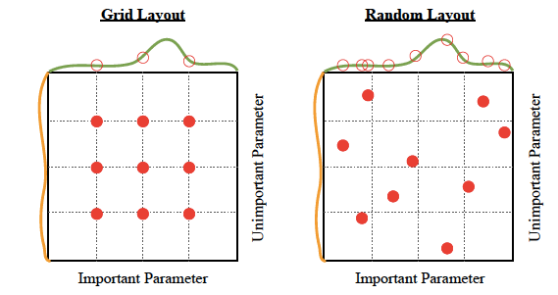
What are drawbacks of grid search ?
Drawbacks of Grid search
It is very slow
Checking every combination require a lot of time

Slide 5
What is Random search ?
Random search is a technique where random combinations of hyperparameters are used to find best solution for building model.
Random search works best for lower dimensional data since the time taken to find the right set is less with less number of iterations.
This works best under the assumption that not all hyperparameters are equally important.
Drawback of random search is that it yields high variance during computing.
Since no intelligence is used to sample these combinations, luck plays its part.

Slide 6
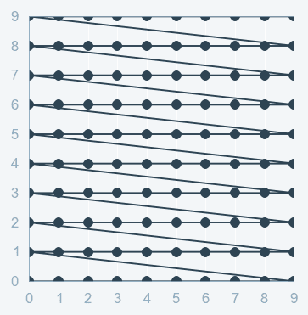
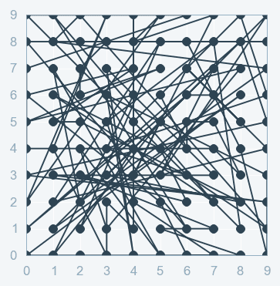
Grid Search
Random Search

